Slide 1
INTERNATIONAL ASSOCIATION OF CHIEFS OF
POLICE
JUNE 8, 2023

Slide 2

VISION
Shaping the Future of the Policing Profession
MISSION
The International Association of Chiefs of Police advances the policing profession through advocacy, research, outreach, and education.

Slide 3

IACP MEMBERSHIP
Over 33,000 members in 170 countries
Law Enforcement Leaders
  Federal, State, Local, Tribal, Campus, and special agencies
Mid-Level Leaders
  Commanders, Captains, Lieutenants, and Sergeants
Line Officers
University Professors and Students
Private Sector Leaders
…AND Victim Advocates and Support Professionals!

Slide 4
IACP BOARD OF DIRECTORS
Executive Board – Elected by Membership (15)
33 Appointed Members
7 are World Regional Chairs
Ensures Global Representation
7 Ex-Officio Members (FBI, DEA, Interpol, Division Vice-Chairs, etc.)

Slide 5
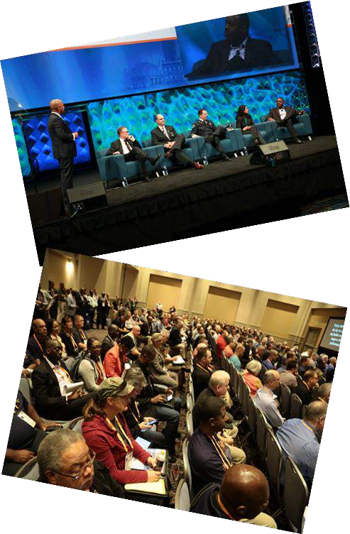
PARTICIPATE AND LEARN
9 Policy Councils – Coordination of Effort
27 Committees
  30 members
  Minimum of 3 members must be from outside North America
  Victim Services Committee
22 Sections
  Unlimited number of members
  Elect their own leadership of the Section
4 Divisions
  SACOP, Mid-Sized Agencies, State and Provincial Police, International Policing

Slide 6
GLOBAL POLICING INITIATIVES
During the past several of years, the IACP Board of Directors has supported the vision to advance the policing profession on a truly international scale. This enhanced focus included an investment in a staffing prioritizing and highlighting global initiatives in the IACP’s strategic plan.
Bloomberg Initiative for Global Road Safety
Global Road Safety Leadership Course - Kenya
Migrant Smuggling Operations, etc. – Dominican Republic
IACP/UAE Academy Exchange
ANZPAA Conference and Visit – Australia
Delegation Visit – Kyrgyzstan
Roundtable on Police Cultural Transformation – Ireland/Scotland/Malta
World Police Summit - Dubai
Domestic and Sexual/Gender Based Violence Investigation Training - Nigeria
Law Enforcement Partnership with Women’s Justice Centers - Mexico

Slide 7


GLOBAL POLICING INITIATIVES
Current Memorandums of Understanding (MOU):
Canadian Association of Chiefs of Police (CACP) – 2022
RoadPol - 2022
Interpol – 2022
United Nations Road Safety Collaboration – 2021
Association of Caribbean Chiefs of Police (ACCP) – 2020
The Cooperation Council for the Arab States of the Gulf (GCCPOL) – 2019
Ministry of Interior, United Arab Emirates – 2019
Pacific Islands Chiefs of Police (PICP) – 2019
  Europol – 2014
Offices
Alexandria, VA (Headquarters)
Abu Dhabi, UAE
Seoul, South Korea
Others being considered

Slide 8
THE IACP HAS PRIORITIZED:
Building the capacity of law enforcement agencies to respond to gender- based violence crimes.
Raising awareness of the importance of creating fundamental changes by incorporating a victim-centered and trauma-informed approach while holding offenders accountable.
Community trust and victim-centered approaches in policing are interconnected and mutually reinforcing. Establishing community trust is crucial for implementing effective victim-centered strategies, while victim- centered approaches help build and maintain community trust by prioritizing the needs, rights, and well-being of victims. This symbiotic relationship is essential for creating safer, more supportive communities.

Slide 9
TRUST BUILDING CAMPAIGN
“….seeks to enhance trust between a community and their police agency to promote safe, effective
interactions and ensure police agencies and communities have the collective capacity to prevent and
reduce crime, and to improve the overall wellbeing and quality of life for all.”
To join the campaign, police agencies must pledge, over the next 36 months, to implement key
policies and adopt promising practices in six key focus areas that are essential to enhance the trust and collaboration between a police department and its community. These key areas are:
Bias-Free Policing
Use of Force
Leadership and Culture
Recruitment, Hiring, and Retention
Victim Services
Community Relations
IACP Trust Building Campaign | International Association of Chiefs of Police (theiacp.org)

Slide 10

TRUST BUILDING CAMPAIGN

Slide 11
VICTIM SERVICES
The Trust Building Campaign webpage includes resources to assist agencies in implementing the best practices associated with this tenet, which are as follows:
  Train officers in trauma-informed responses.
  Train officers on best practices, resources, and tools for communicating with community members who do not speak the national language or whose ability to communicate is impaired (e.g., people who are hard of hearing or deaf).
  Establish partnerships to provide for mental health, substance abuse, and youth deflection/diversion resources in their community.

Slide 12
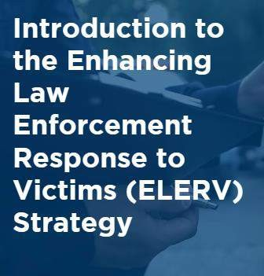
ENHANCING LAW ENFORCEMENT RESPONSE TO VICTIMS (ELERV)
Led by the IACP, ELERV was designed to create a cultural and fundamental change within the United States law enforcement community by helping establish a systematic and comprehensive approach to meeting victims’ needs.
Leadership
Partnering
Training
Performance Monitoring

Slide 13
ENHANCING LAW ENFORCEMENT RESPONSE TO VICTIMS (ELERV)

Slide 14
IACP Publications
Quick Reference: Victim Services Role – includes an overview of the role of law enforcement-based victim services.
Quick Reference: Getting Started – includes a 5-step process to develop law enforcement-based victim services.
Law Enforcement-Based Victim Services: Key Considerations & Key Considerations Checklist – provides an overview of foundational topics for law enforcement-based victim services.
Agency Self-Assessment and accompanying Community Assessment –intended to assist agencies in reviewing and evaluating current policies and practices related to domestic violence, sexual violence, stalking, and strangulation.

Slide 15
Topic-Specific Web Pages - www.TheIACP.org
Law Enforcement-Based Victim Services (LEV)
Police Response to Violence Against Women
Identifying and Preventing Gender Bias
T rauma‐Informed Sexual Assault Investigation Training
Enhancing Rural Law Enforcement Response to Violence Against Women

Slide 16
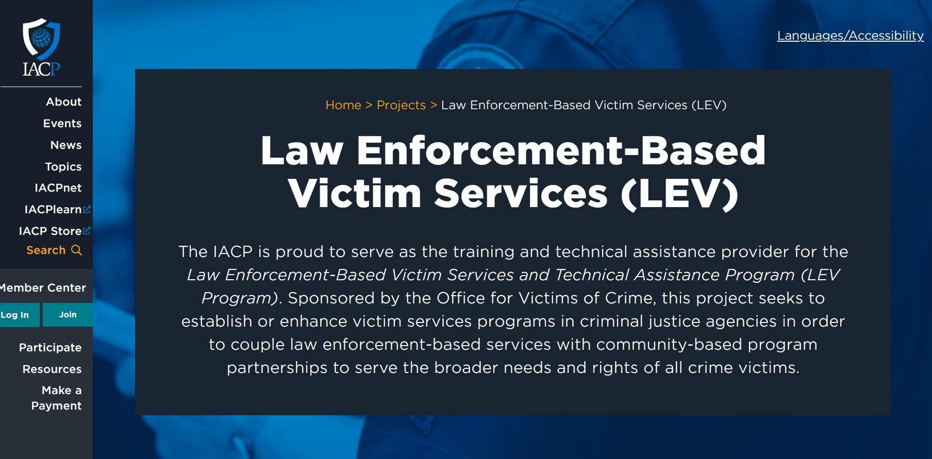

Slide 17
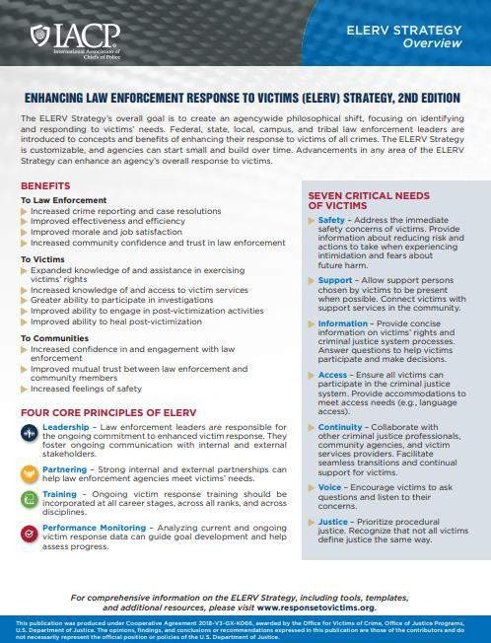
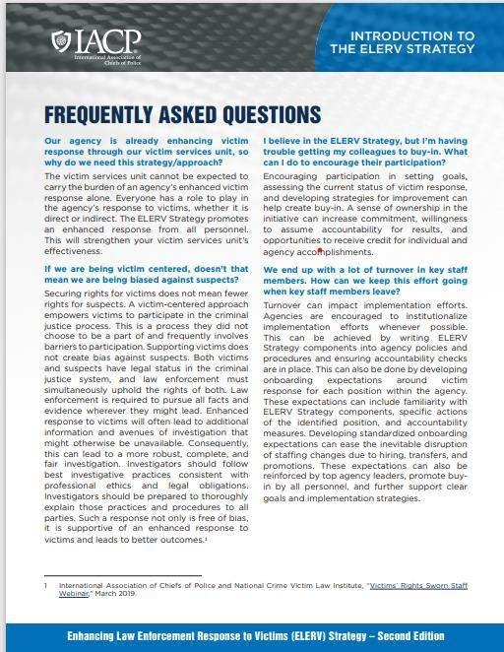
Victim Services | International Association of Chiefs of Police (theiacp.org)

Slide 18
WHY IS THIS IMPORTANT?
Many US based Victim Advocates are part of
prosecutors’ offices (local levels)
Focus to also imbed Victim Advocates in law enforcement agencies to provide more holistic services
  Large Agencies
  Federal Agencies
    NY Example – New Program
    NC Example – Grant Funded to Start Program

Slide 19
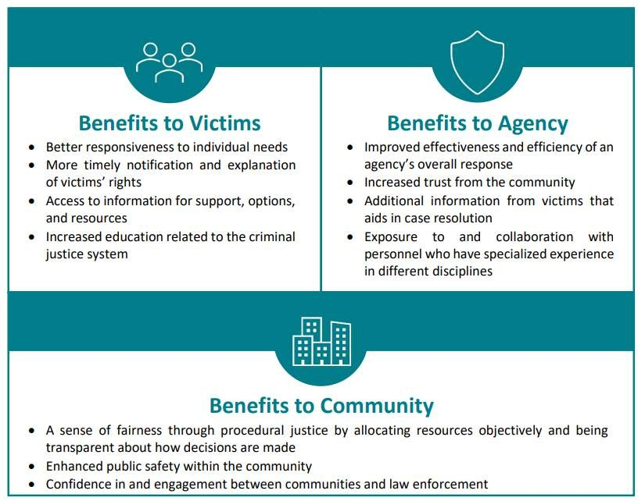
Released by IACP 7 June 2023
Law Enforcement- Based Victim Services: Agency Incorporation of Victim Services
AgencyIncorporationofVictimServices
.pdf (theiacp.org)

Slide 20
JOIN NOW
Open to all policing professionals and those affiliated with law enforcement
Learn more about the benefits of membership by visiting www.theIACP.org/membership and join today to get more involved.
2023 Annual Conference and Exposition
San Diego, CA October 14-17, 2023

Slide 21






THANK YOU!
Chief John Letteney Thomasville (GA) Police Department
President – IACP
Letteney@TheIACP.org (229) 403-2030
www.theIACP.org/membership

