Slide 1


Safeguarding Freedom of Religion in Europe
#VSEAC2023 – Berlin, June 7th 2023
Elie Kagan
Head of Crisis Management SACC by EJC

Slide 2
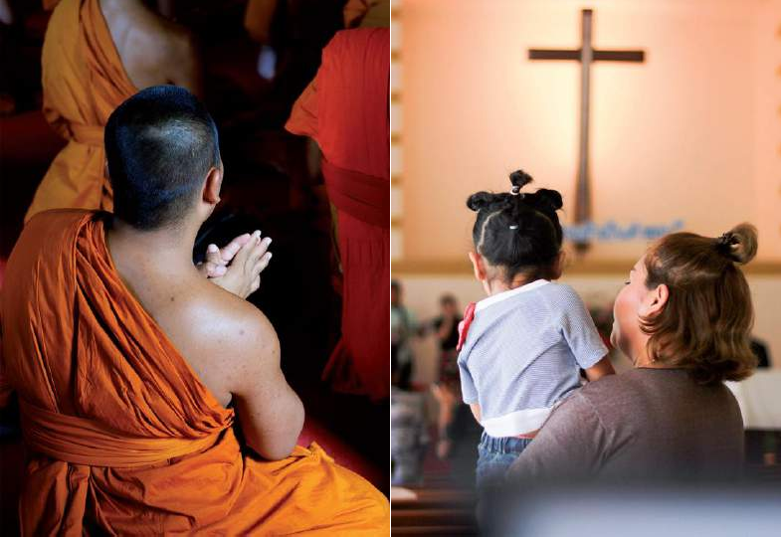
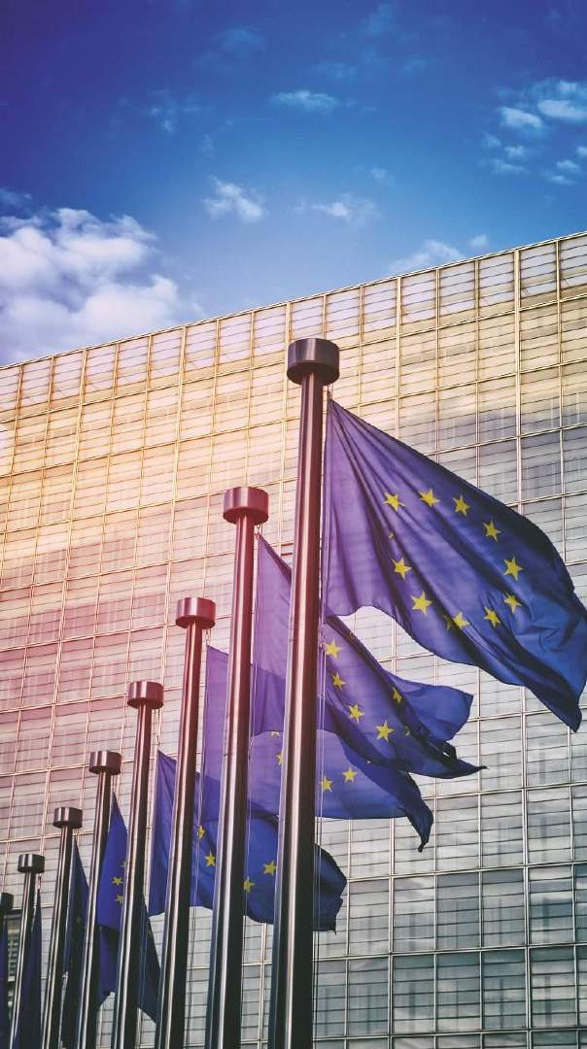
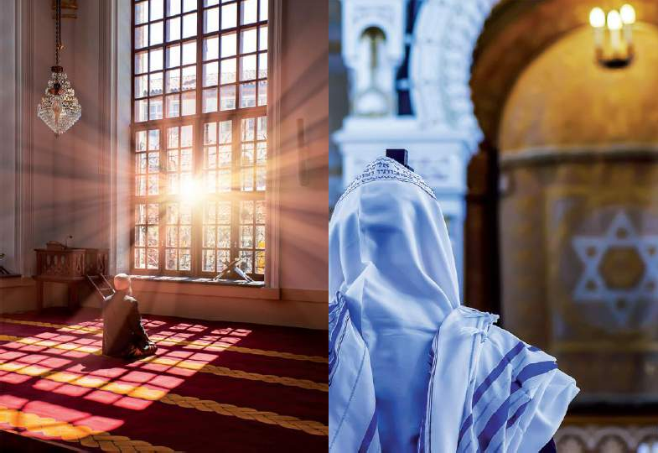

Slide 3
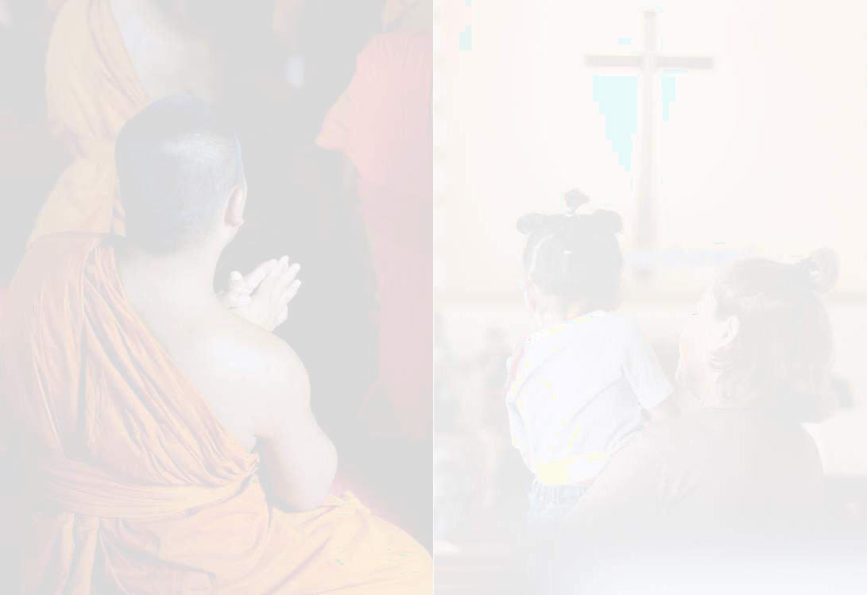



The 4 Pillars
Article 18 of the Universal Declaration of Human Rights Everyone has the right to freedom of thought, conscience and religion; this right includes freedom to change his religion or belief, and freedom, either alone or in community with others and in public or private, to manifest his religion or belief in teaching, practice, worship and observance.
Article 9 of the European Convention on Human Rights –
Freedom of thought, conscience and religion
Everyone has the right to freedom of thought, conscience and religion; this right includes freedom to change her/his religion or belief and freedom, either alone or in community with others and in public or private, to manifest her/his religion or belief, in worship, teaching, practice and observance.
Freedom to manifest one's religion or beliefs shall be subject only to such limitations as are prescribed by law and are necessary in a democratic society in the interests of public safety, for the protection of public order, health or morals, or for the protection of the rights and freedoms of others.
Article 10 of the Charter of Fundamental Rights of the EU
Everyone has the right to freedom of thought, conscience and religion. This right includes freedom to change religion or belief and freedom, either alone or in community with others and in public or in private, to manifest religion or belief, in worship, teaching, practice and observance.
The right to conscientious objection is recognised, in accordance with the national laws governing the exercise of this right.
Article 17 of the Treaty on the Functioning of the EU (TFEU), introduced by the Treaty of Lisbon, provides for the first time, a legal basis for an open, transparent and regular dialogue between the EU institutions and churches, religious associations, and philosophical and non-confessional organisations. It states:
The Union respects and does not prejudice the status under national law of churches and religious associations or communities in the Member States.
The Union equally respects the status under national law of philosophical and non-confessional organisations.
Recognising their identity and their specific contribution, the Union shall maintain an open, transparent and regular dialogue with these churches and organisations.

Slide 4
Challenges
Majority vs
Animal welfare vs
traditions (Hallal, Kosher)
Security
Hate crimes
Minority relations
Circumcision
Building places of worship
threats
Terrorism

Slide 5
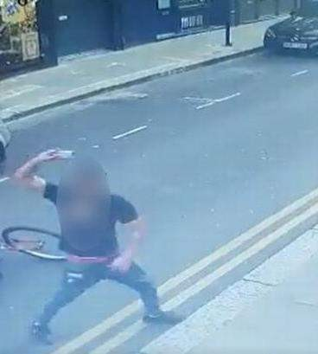
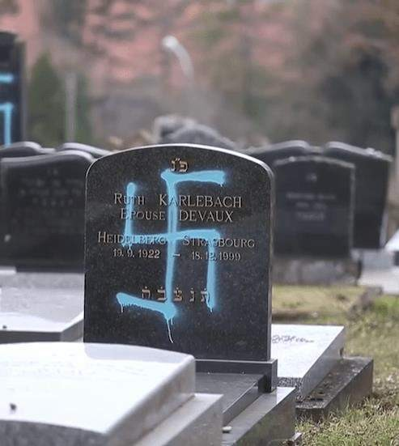
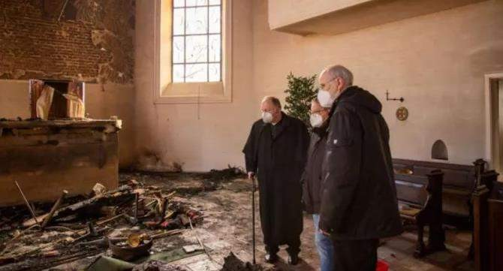
Security threats
Online/social media/gaming abuse
Insult/Harassment
Vandalism/Graffiti
Desecration
Theft
Arson
Kidnapping
Violent assault
Stabbing attack
Hostage taking
Car ramming
Active shooter
Explosive

Slide 6
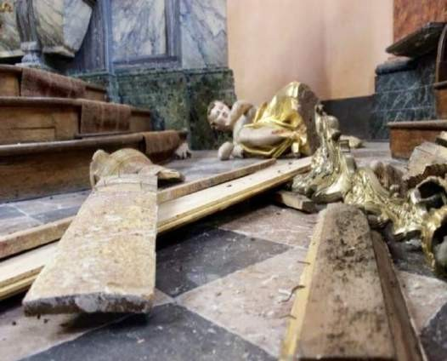
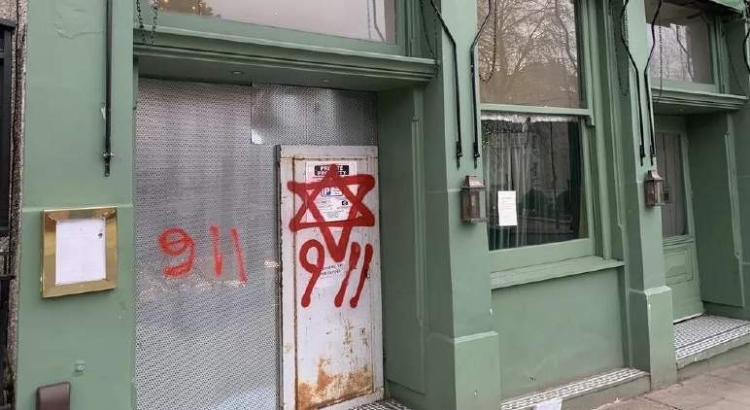
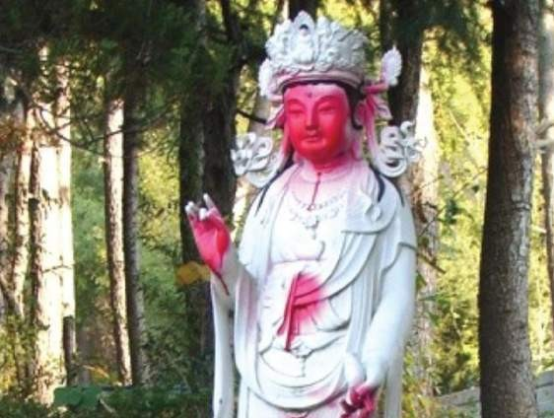
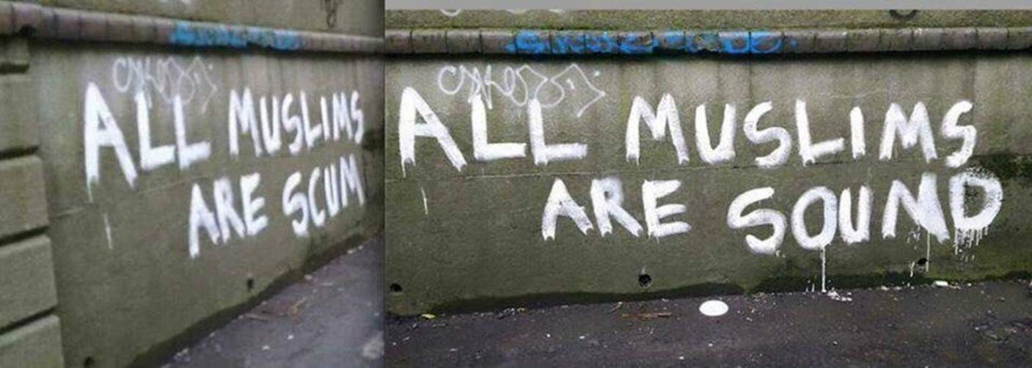
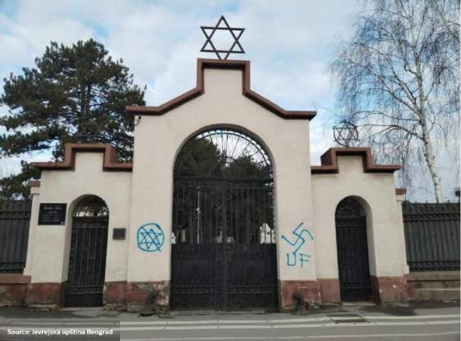
Hatred and Radicalism

Slide 7
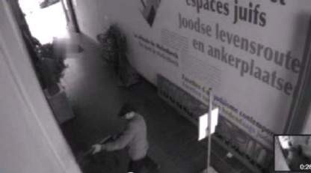
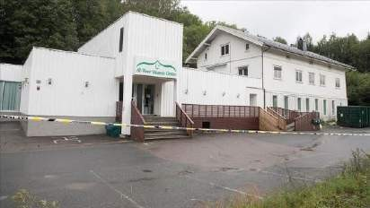
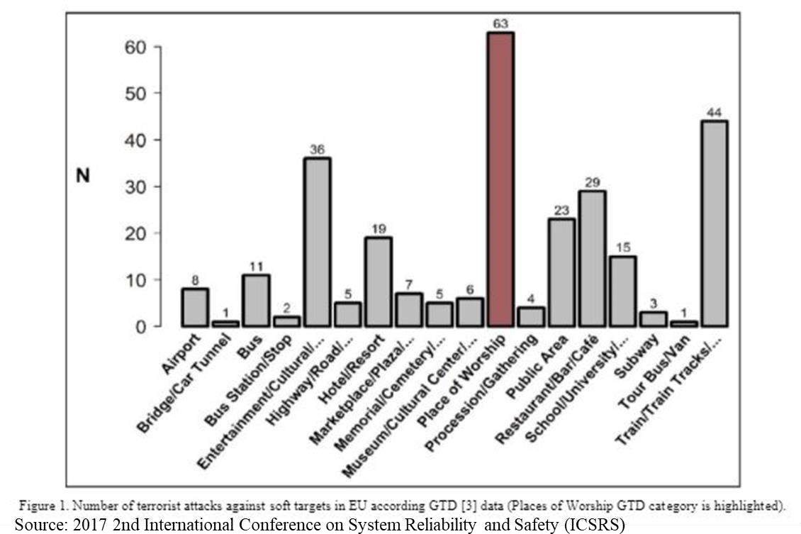
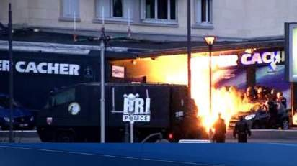
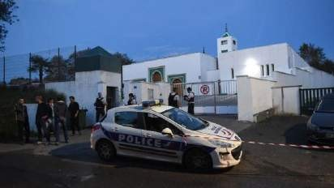
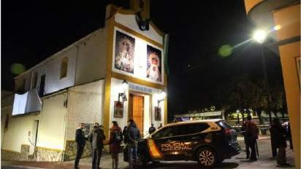
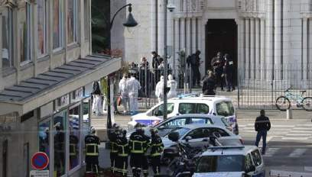
Terrorism

Slide 8

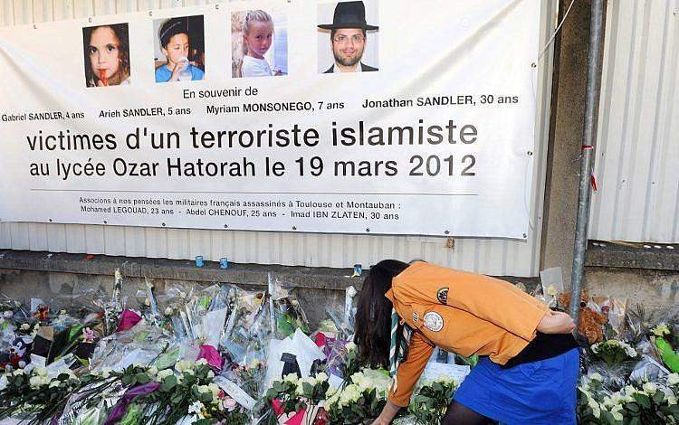
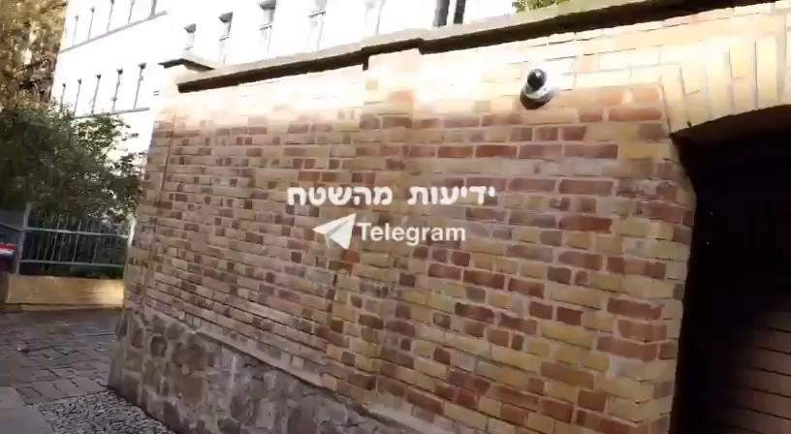

Case studies

Slide 9













The threat
Crisis Management
Physical/Tech nical means
Safeguarding faith communities
Cooperation with public authorities
Security operators/
volunteers
Deal with any suspicious activity
Procedures Training
Security awareness
Keep doors shut

Slide 10







Safer And Stronger Communities in Europe
Goal:
SASCE is a multi-layered project to dramatically increase security in and around places of worship, as well as within and between Christian, Buddhist, Muslim and Jewish communities.
This project covers 4 scopes:
Topics:
Reports
Basic tools of Security
Security Awareness
Crisis Management
Partners:
Conference of European Churches
European Buddhist Union
Faith Matters
Security and Crisis Center by the European Jewish Congress
Countries:
Austria, Belgium, Croatia, Estonia, France, Finland, Germany, Greece, Hungary, Italy, Netherlands, Spain, Sweden
Poland, Portugal,

Slide 11


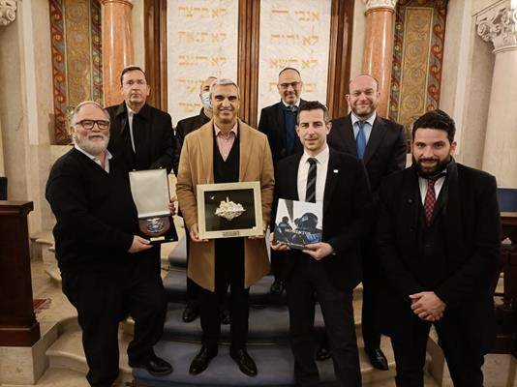
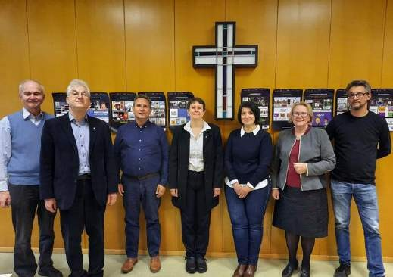
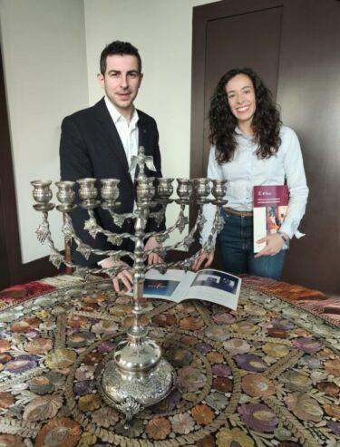
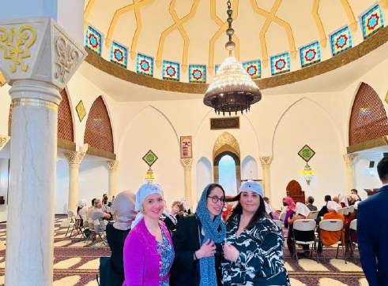
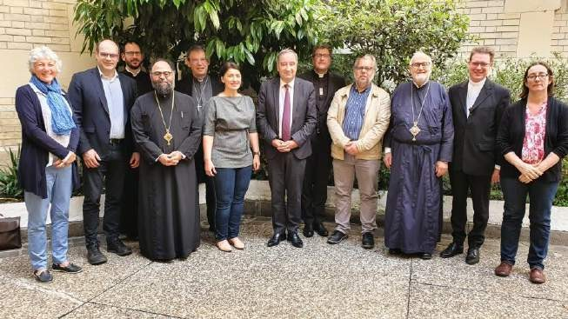



Safer And Stronger Communities in Europe

Slide 12
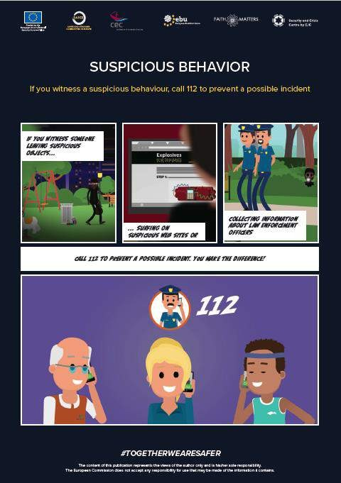
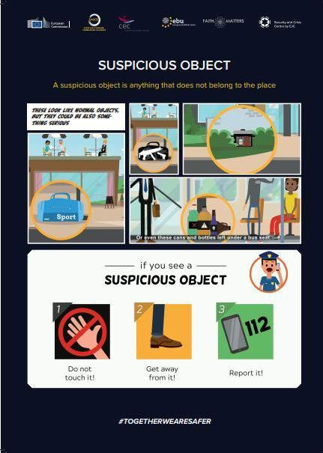
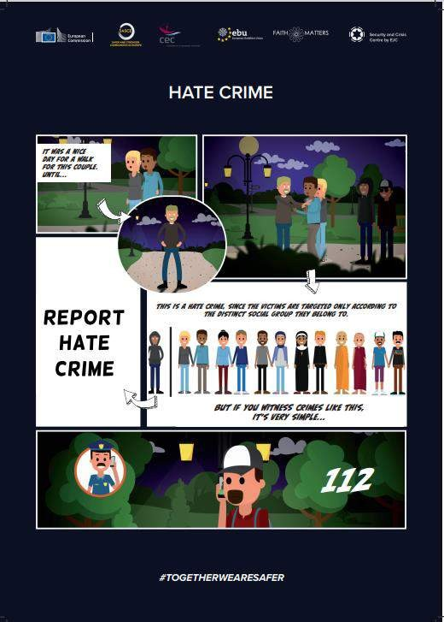
Safer And Stronger Communities in Europe

Slide 13

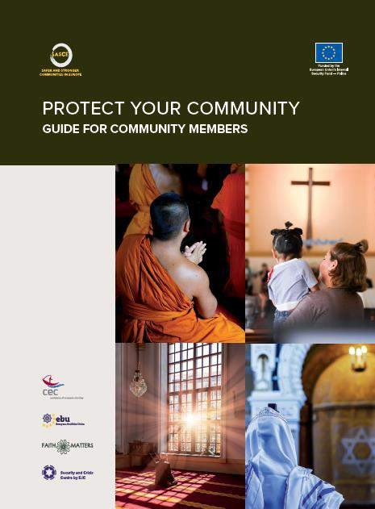
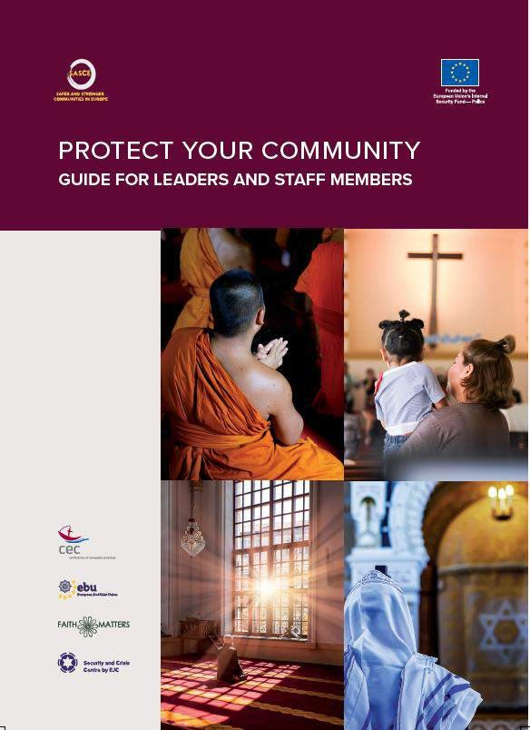
Impact on the Communities
Community
Members
More resilient Community
volunteering
New normal
Development of new skills
Faith Organisations
Leadership better
prepared
Development of new programmes
Partnership with
authorities
Change of mindset
Additional expenses

Slide 14

A global challenge
Education and awareness programmes
Combat hatred online
Report hate crimes
Improvements
Develop cooperation with public authorities
Promote successful projects
Interfaith dialogue
Victim support
Legal aspect
Financial support

Slide 15
